Slide 1
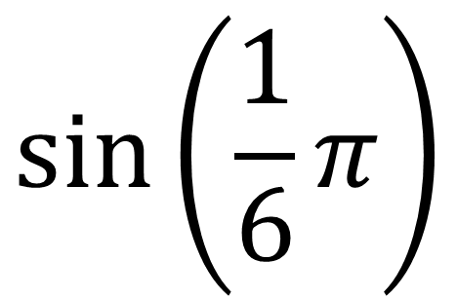
$$sin⁡\left(\frac{1}{6}π\right)$$

Slide 2
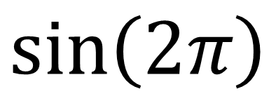
$$sin⁡\left(2π\right)$$

Slide 3
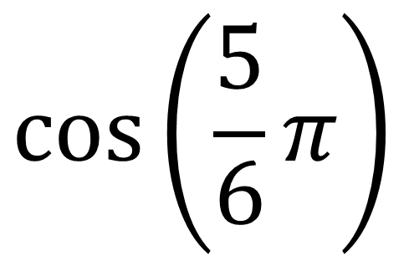
$$cos⁡\left(\frac{5}{6}π\right)$$

Slide 4
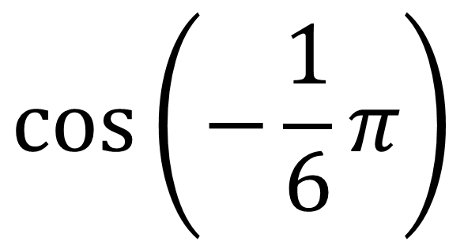
$$cos⁡\left(−\frac{1}{6}π\right)$$

Slide 5
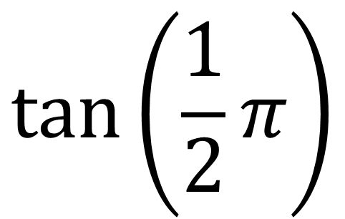
$$tan⁡\left(\frac{1}{2}π\right)$$

Slide 6
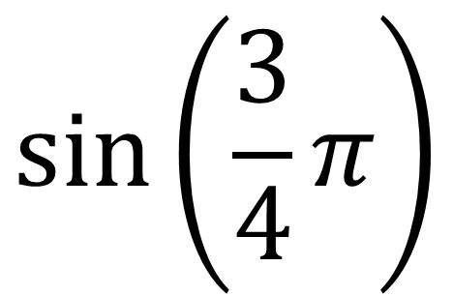
$$sin⁡\left(\frac{3}{4}π\right)$$

Slide 7
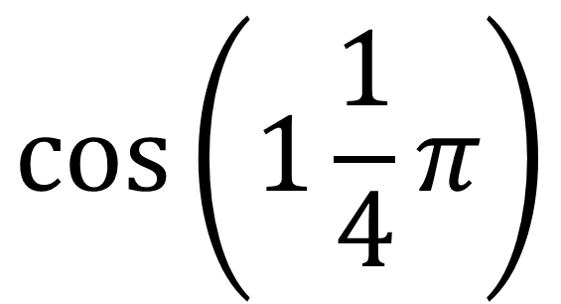
$$cos⁡\left(1\frac{1}{4}π\right)$$

Slide 8
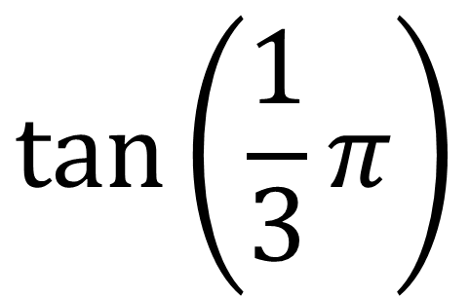
$$tan⁡\left(\frac{1}{3}π\right)$$

Slide 9
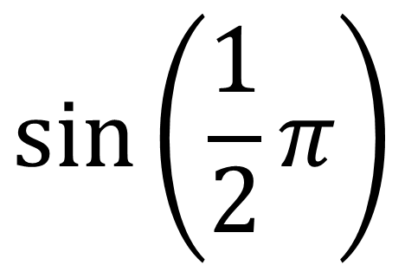
$$sin⁡\left(\frac{1}{2}π\right)$$

Slide 10
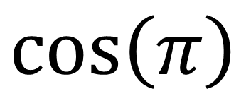
$$cos⁡\left(π\right)$$

Slide 11
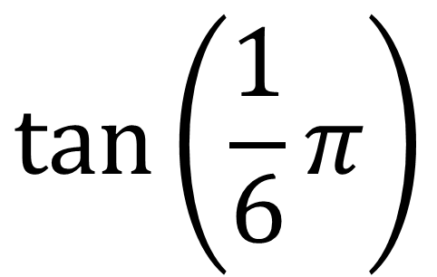
$$tan⁡\left(\frac{1}{6}π\right)$$

Slide 12
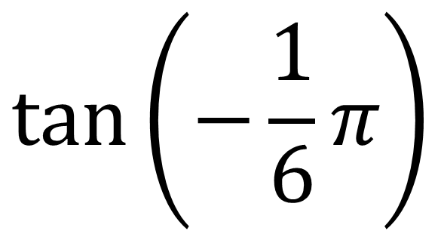
$$tan⁡\left(−\frac{1}{6}π\right)$$

Slide 13
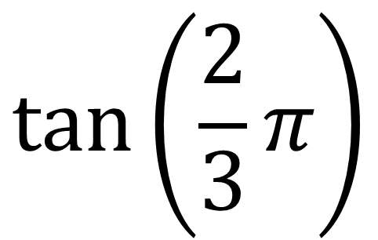
$$tan⁡\left(\frac{2}{3}π\right)$$

